Slide 1

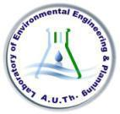
Efthymios Darakas
Professor
Aristotle University of Thessaloniki
Department of Civil Engineering
Laboratory of Environmental Engineering & Planning
Contact:
Personal website: http://users.auth.gr/darakas
E-mail: darakas@civil.auth.gr
Phone: + 30 2310 995719
ERASMUS+ “Lifelong Learning”
Thessaloniki, Oct 30, 2019
“Strengthening of master curricula in water resources management for the Western Balkans HEIs and stakeholders”

Slide 2
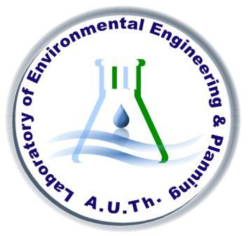
Laboratory of Environmental Engineering & Planning (LEEP)
Established 1982
Certification:
Quality management system according to standard ISO 9001 : 2015 in the field: “Quality assessment of water, wastewater and solid waste”

Slide 3
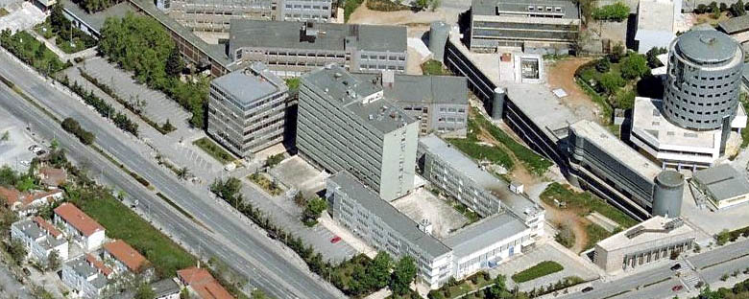
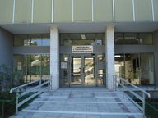
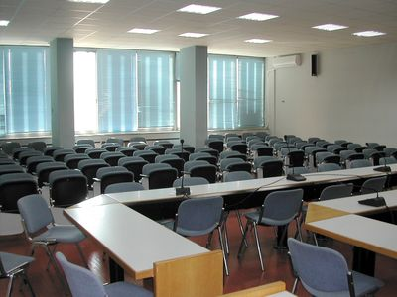
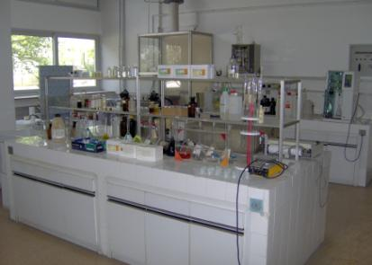
Aristotle University of Thessaloniki
Department of Civil Engineering
Laboratory of Environmental Engineering & Planning
Department of Civil Engineering
Division of Hydraulics & Environmental Engineering

Slide 4
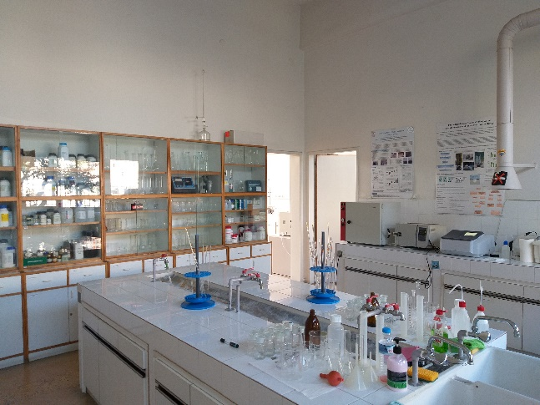
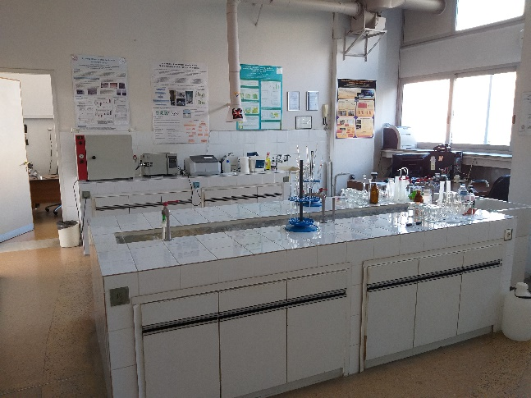
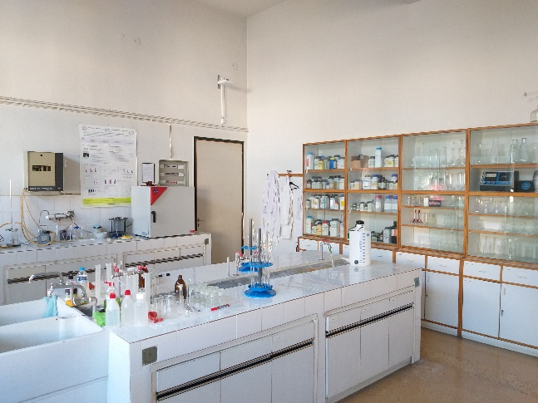
Main activities – Scientific research fields/interests
The laboratory:
  contributes to the educational and research activities of our Department (environmental education issues),
  supports the implementation of experimental graduate and postgraduate theses, (doctoral and postdoctoral research).
Funded research programs are of grate interest, (Research programs dealing with: Management and treatment of water, wastewater and solid waste).

Slide 5
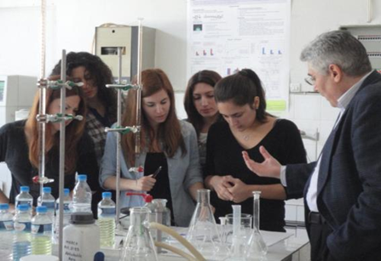
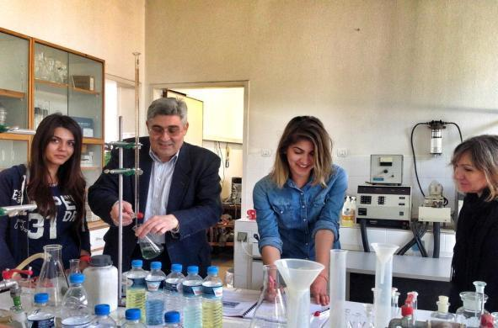
Laboratory of Environmental Engineering & Planning
Educational and research activities
Examples of courses taught:
Environmental Engineering - Wastewater treatment (Core)
Waste Management (Postgraduate)
Laboratory methods for Water and Wastewater Quality Assessment (Elective - Laboratory)
Water – Wastewater Treatment Processes (Elective)
Municipal Solid Waste Management (Elective)

Slide 6
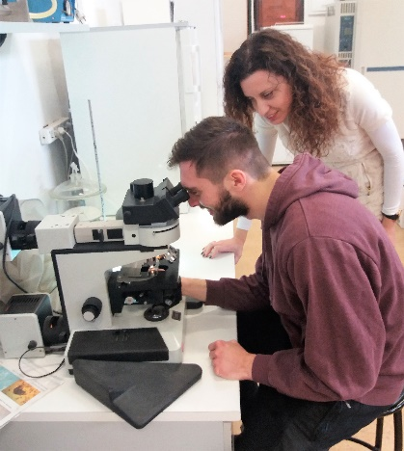
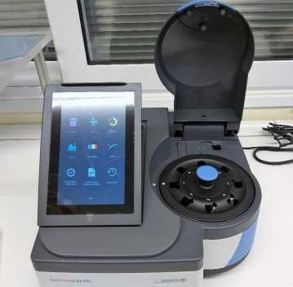
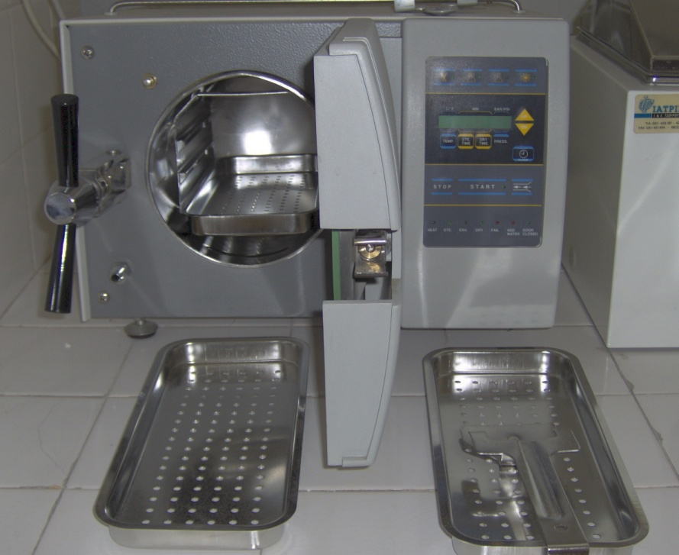
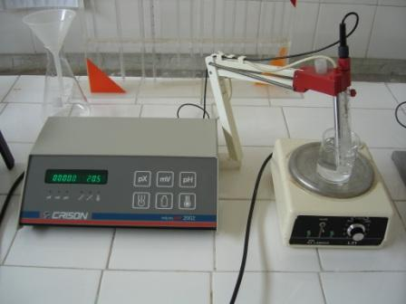
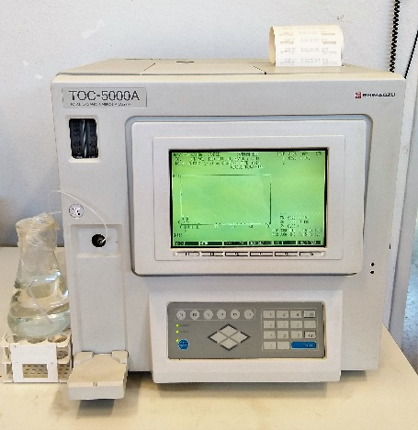
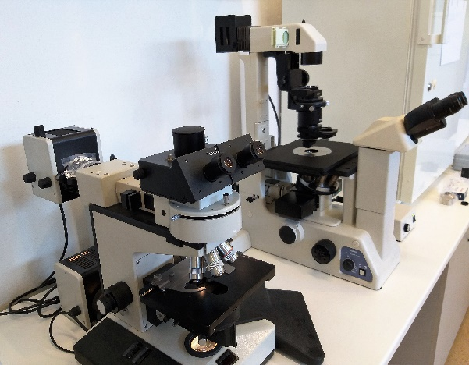
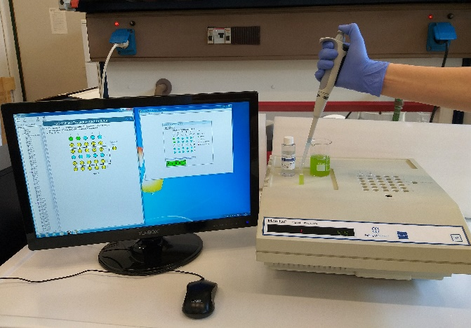
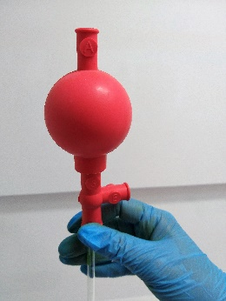
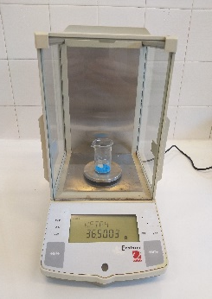
Main activities – Water/wastewater/waste quality control
Chemical, microbiological, ecotoxicological analysis of water, seawater, wastewater and certain chemical compounds (i.e. engineered nanoparticles)
TOC Analysis
UV-Vis spectrometers, autoclaves, bench meters etc
Microscopes
Microtox

Slide 7
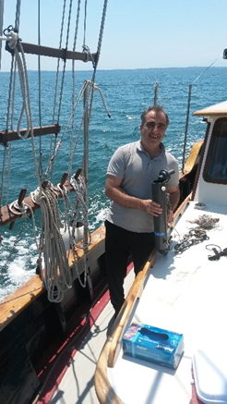
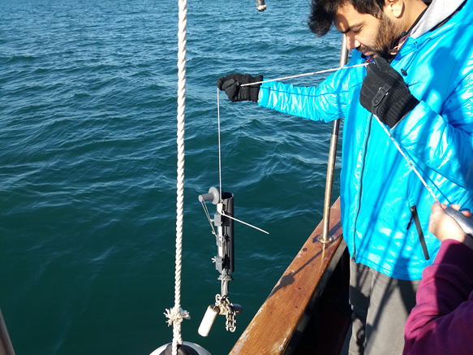
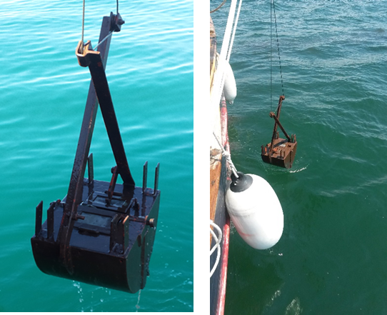
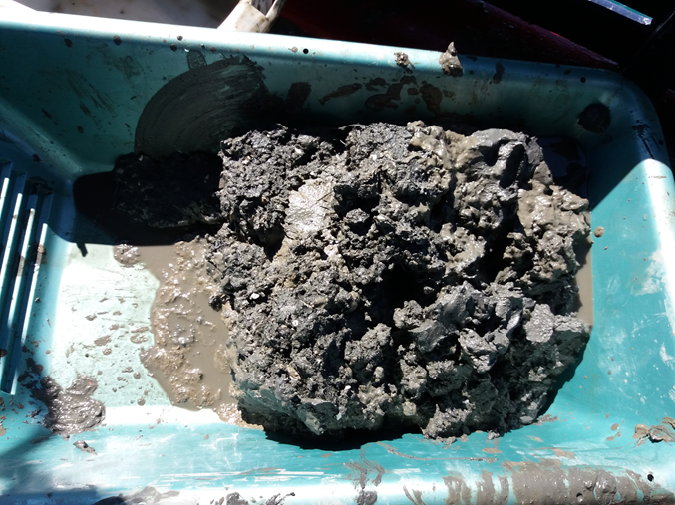
Main activities – Water/wastewater/waste quality control
Seawater and sediment sampling
Research Program: “Monitoring the Marine Environment of Thermaikos Gulf”
A collaboration between:
  Laboratory of Environmental Engineering & Planning,
  Laboratory of Maritime Engineering and Maritime works (Department of Civil Engineering)
  Laboratory of Botany, (Department of Biology)
  Laboratory of marine and terrestrial animal diversity, (Department of Biology)

Slide 8
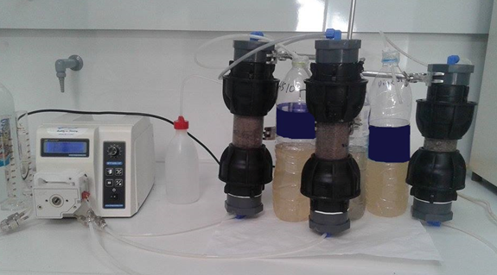
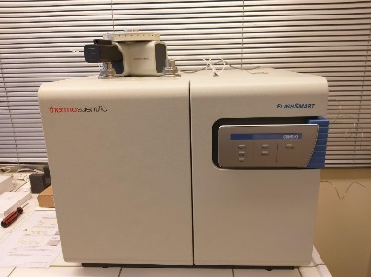
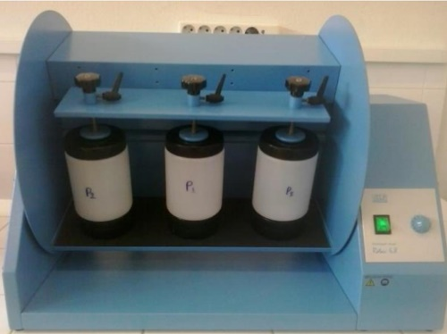
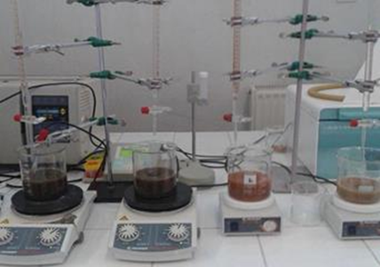
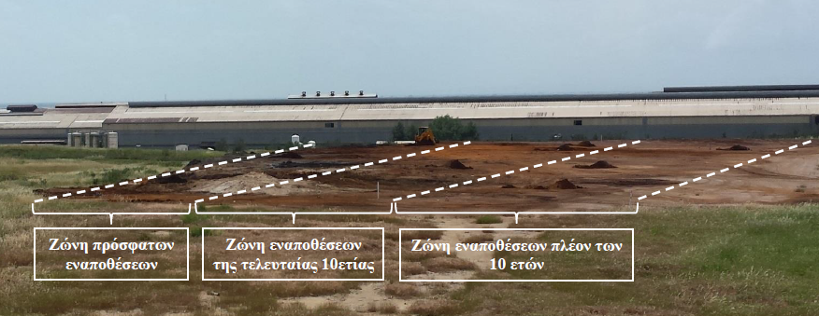
Main activities – Water/wastewater/waste quality control
Sampling planning, analysis and characterization of soils and solid wastes
Leaching, chemical / ecotoxicological analysis and characterization of soil, sludge and solid wastes
CHNS/O Elemental analysis
Sampling plan

Slide 9
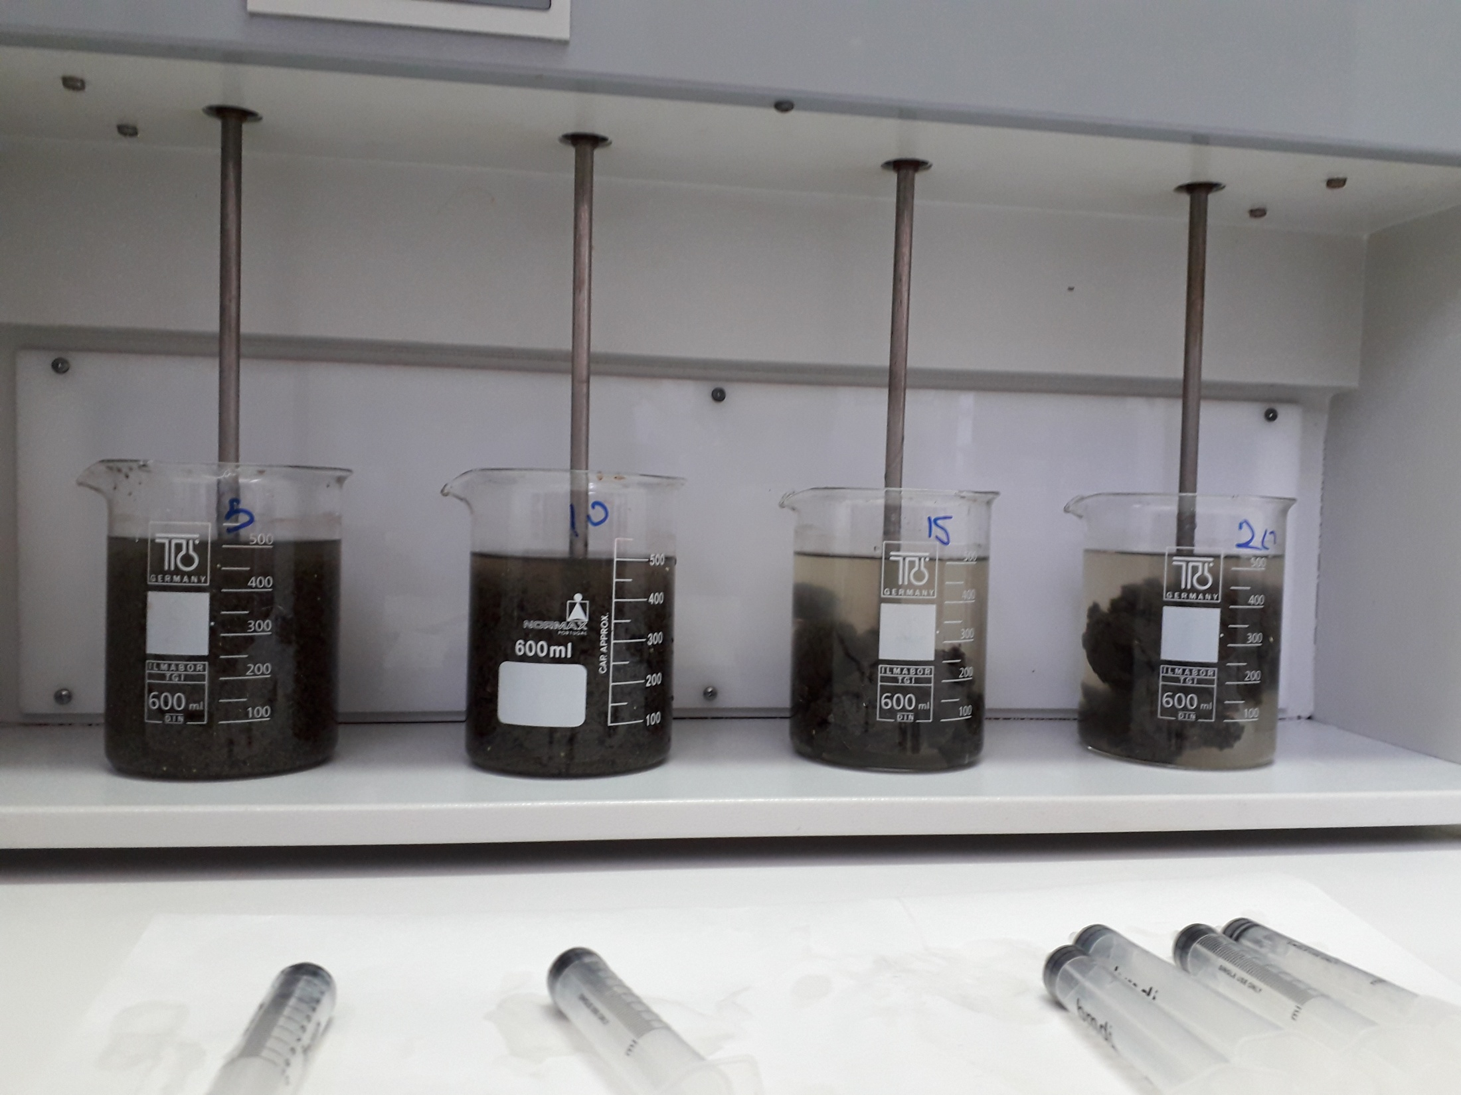
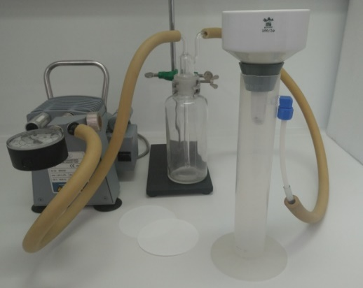
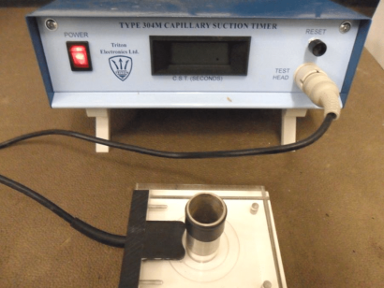
Main activities – Water/wastewater/waste quality control
Sludge treatment / methane production potential during anaerobic treatment
Biomethane Potential (Residual Biogas Potential test set)
Chemical treatment of sludge (Study of dehydration capacity)

Slide 10
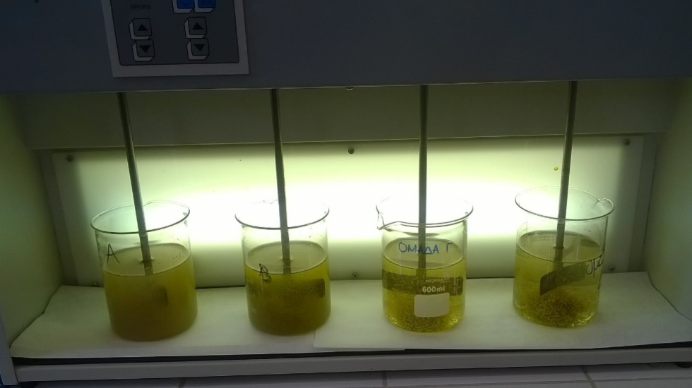
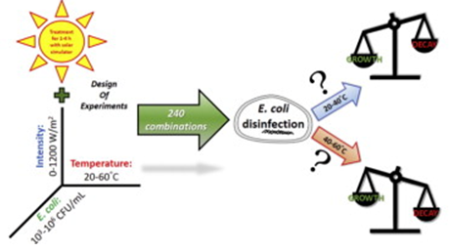
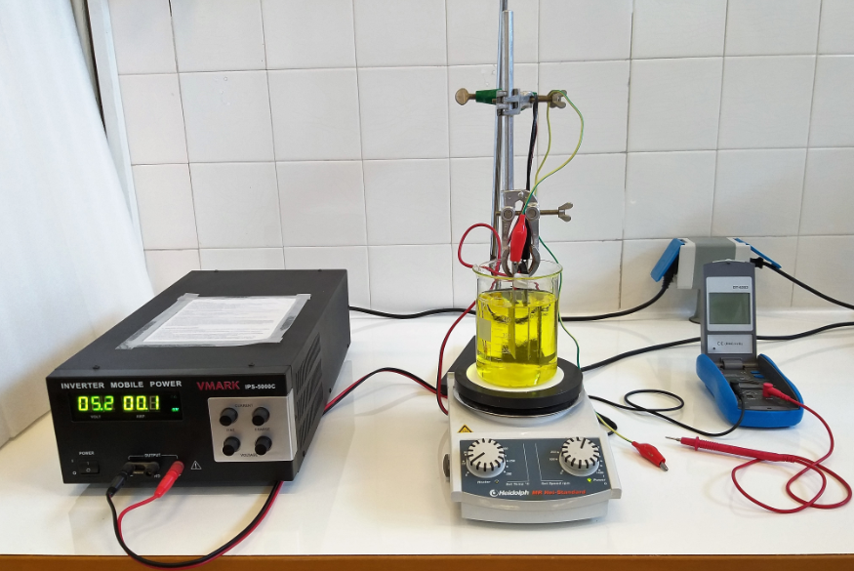
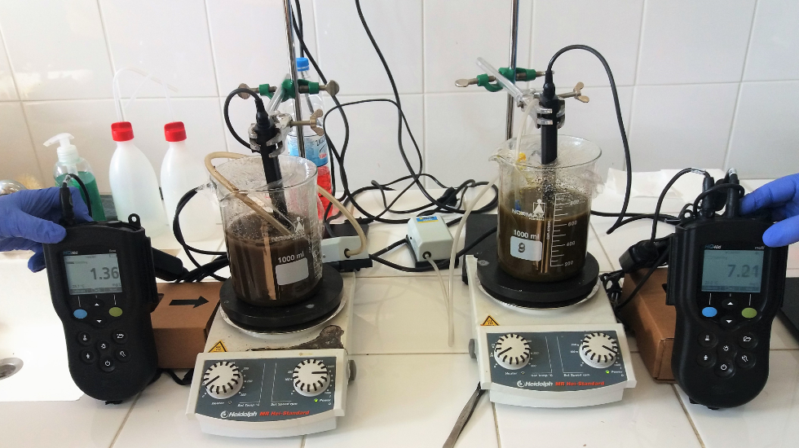
Main activities – Water/wastewater/waste quality control
Chemical and biological treatment of water and wastewater
Disinfection (solar) of water and wastewater effluents
Coagulation
Biodegradability studies of various wastewater streams
studies of water, wastewater and effluents
Electrocoagulation

Slide 11
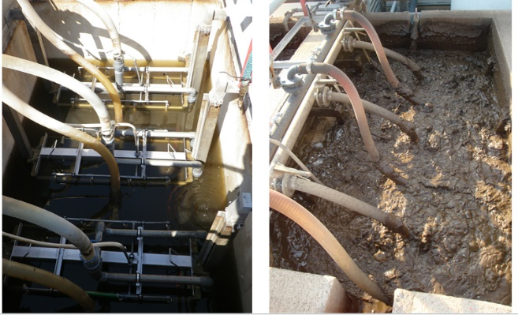
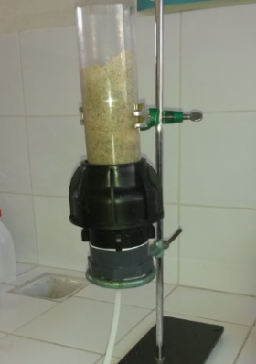
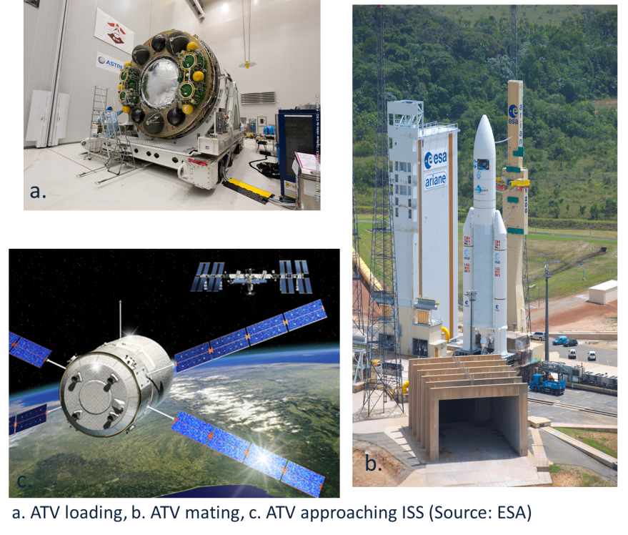
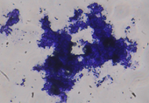
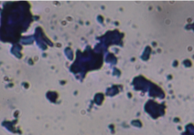
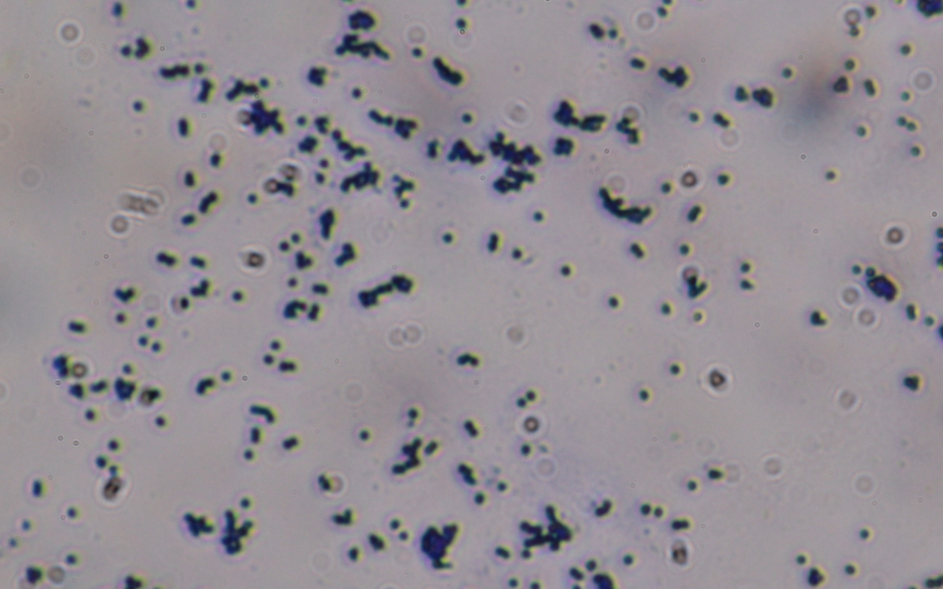
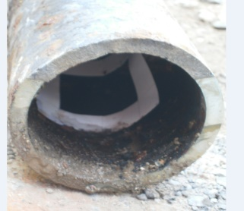
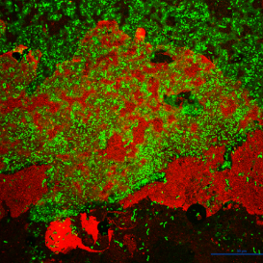
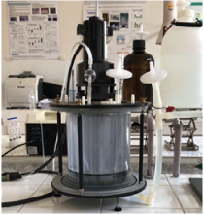
Main activities – Water/wastewater/waste quality control
Monitoring of Membrane BioReactor (MBR) systems for wastewater treatment – filtration of water
Disinfection of potable water consumed in International Space Station (ISS)
Biofilms in drinking water distribution systems and industrial processes

Slide 12
Activities - International Conferences
19th International Symposium on Toxicity Assessment, 25-30 August 2019, Thessaloniki, Greece
7th International conference on Environmental Management, Engineering, Planning and Economics (CEMEPE) and SECOTOX Conference, May 19-24, 2019, Mykonos island, Greece
5th International Symposium on Green Chemistry, sustainable development and circular economy, September 30-October 03, 2018, Skiathos, Greece
5th International Conference on Small and Decentralized Water and Wastewater Treatment Plants, 26-29 August 2018, Thessaloniki, Greece

Slide 13
Activities - Research Projects
Monitoring the Marine Environment of Thermaikos Gulf
Ecotoxicological analyses of
  treated wastewater and chemicals
  biosolids from wastewater treatment plants of EYDAP S.A.
  various types of sludge from WWTP of EYATH S.A.
  Biocide management for long term water storage
Environmental impact assessment of hotel development in Paliouri, Chalkidiki
Sampling and analyzes of solid wastes from HELLENIC STEEL COMPANY S.A.
INTERREG IPA CBC- AQUA M II “Sustainable management of cross-border water resources”

Slide 14
LEEP / Staff
Prof. A. Kungolos (PhD Chem. Eng.)
As. Prof. A. Zafirakou (PhD Civ. Eng.)
M. Petala (PhD Chem. Eng.)
V. Tsiridis (PhD Chem. Eng.)
D. Ioannidou (MSc Civ. Eng.)
A. Bellou (Chem. Eng.)
S. Bayouk (PhD Arch. Eng.)
M. Samolada (PhD Chem. Eng.)

Slide 15


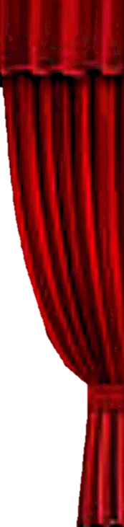

Thank you very much for your attention!

